Slide 1

Hardware Components Interfacing to PLC
Analogue IO Part 1
Contents are mainly from SIMATIC S7-1500 CPU 1512C-1 PN Manual

Slide 2
Learning Outcome
Identify scenarios where analogue devices are required
Describe the common analogue standards used in the industry
Explain the operation of DAC and ADC conversions
Perform scaling and ranging of analogue values

Slide 3
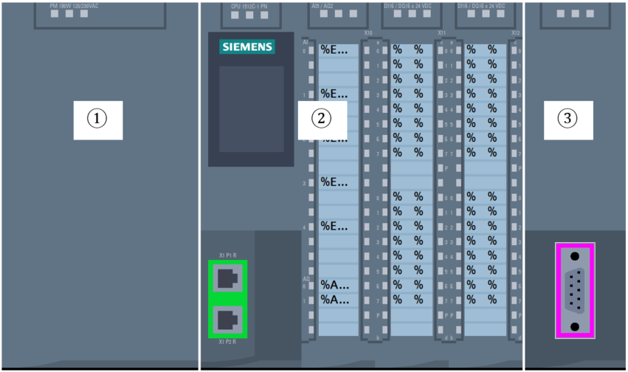
Analog I/O Application
LIT
0
1200mm
300mm
Level
Sensor
600mm
Control System
Open
Valve
Chemical
Tank
Control
Valve
Flow
Sensor
FIT
1.23l/s

Slide 4
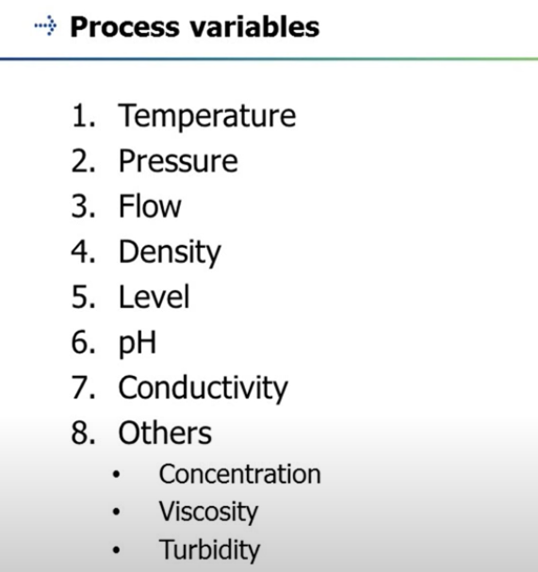
Typical Process Variables

Slide 5
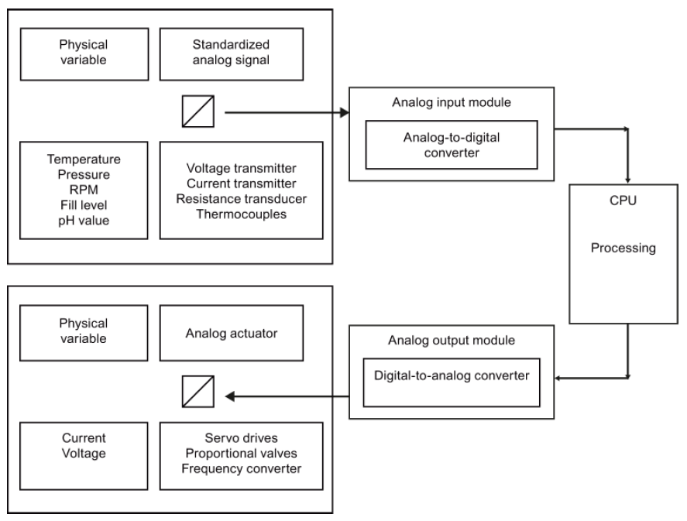
Analog I/O
PLC control with real time processes with discrete and analog variables
Analog signals from sensors need to be converted to digital signals for CPU to process. This is known as Analog to Digital (A/D) Conversion
Similarly the analog output signals from PLC is produced thru Digital to Analog (D/A) Converter
Analog Sensor
ADC
PLC
PLC = Industrial Computer
PLC
DAC
Actuator

Slide 6
ADC and DAC Signal Ranges
It is a large topic for analog conversion. However in this module, the objective is to provide a good overview of necessary information to understand Analog signals better.
Analog signals are commonly available:
4 – 20mA
1 – 5V (effectively 4 – 20mA with 250 ohms precision resistor)
0 – 10V
0 – 5V (effectively 0 – 20mA with 250 ohms precision resistor)
0 – 20mA
4 – 20mA is the standard electronic instrumentation signal
Current does not suffer signal loss such as voltage drop of cables
4mA as lower limit helps to monitor cable break
0 – 10V is easily generated, making it common

Slide 7
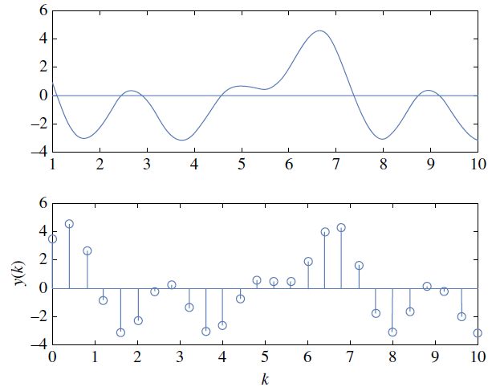
ADC and DAC Resolution
Discrete / digital signal has state of 0 or 1
Conversion of analog signal to digital signal depends on the resolution of the A/D circuit, expressed in bits
Example of a 8-bit converter would give you 2⁸ = 256
0 to 255 unsigned integer
-128 to 127 signed integer
8 bit A/D converter is common in microcontroller
12 and 16 bits A/D converters are common in PLC
Higher the resolution, accuracy would be better
S7-1500 PLC has 16-bit ADC
It means available discrete values = 65,365

Slide 8
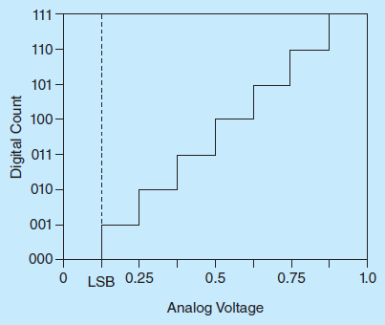
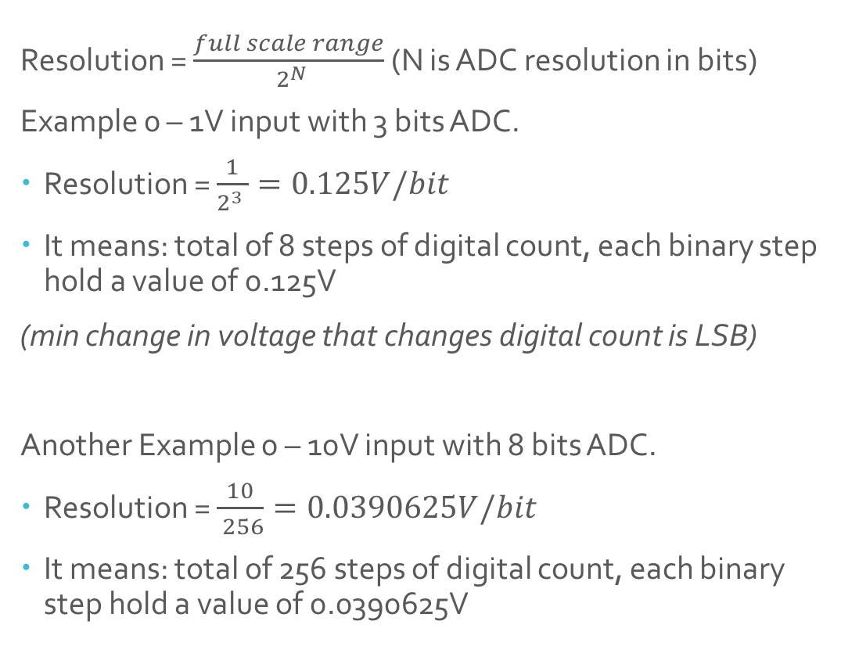
ADC and DAC Resolution
Resolution = $\frac{full scale range}{ 2^{N}}$ (N is ADC resolution in bits)
Example 0 – 1V input with 3 bits ADC.
Resolution = $\frac{1}{2^{3} }=0.125V/bit$
It means: total of 8 steps of digital count, each binary step hold a value of 0.125V
(min change in voltage that changes digital count is LSB)
Another Example 0 – 10V input with 8 bits ADC.
Resolution = $\frac{10}{ 256}=0.0390625V/bit$
It means: total of 256 steps of digital count, each binary step hold a value of 0.0390625V
Notes:
Avg Quantisation error = LSB/2
For the 3 bit case would be 0.125/2 = 0.0625V.
Important to know resolution, as we move to programming, they would understand the scaling.

Slide 9
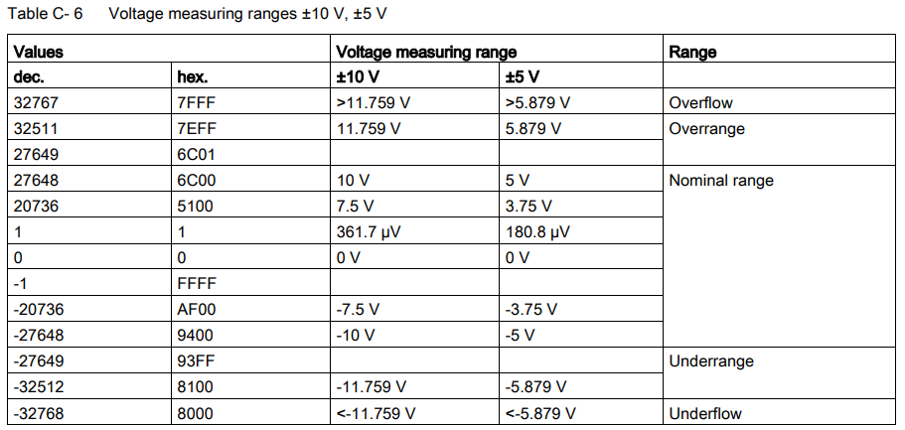
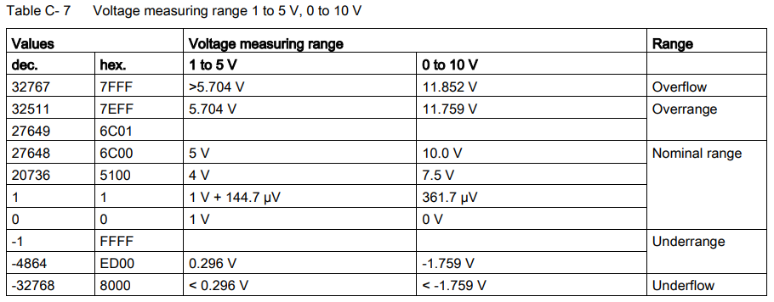
Voltage Measuring Range
16 bits Unsigned integer: 0 to 65,365

Slide 10
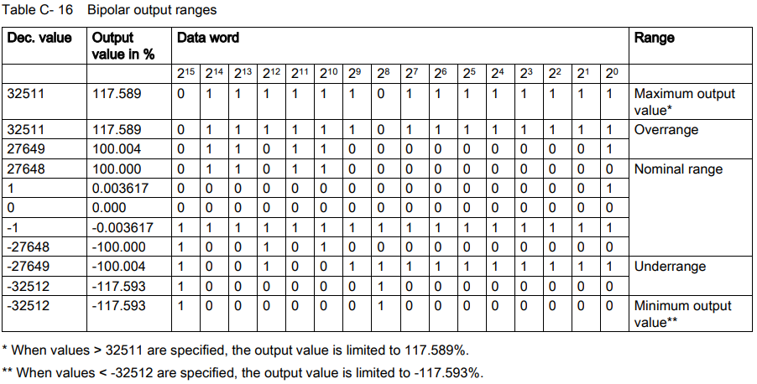
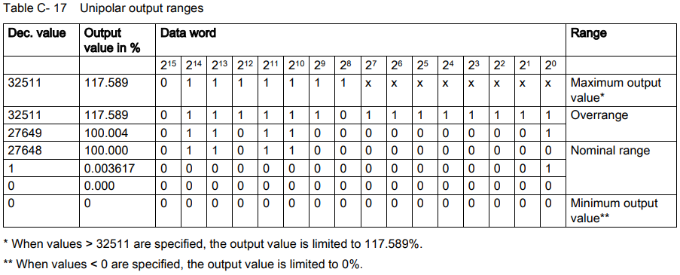
Output Range

Slide 11
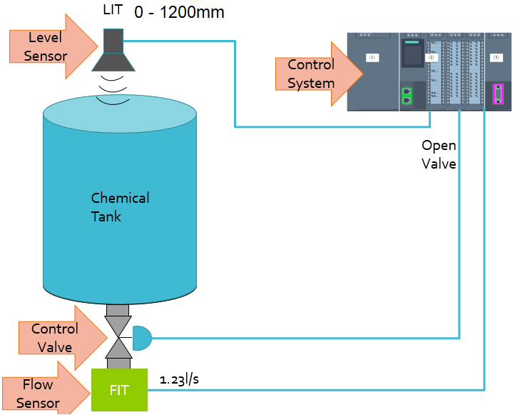
Scaling Analog Values
Scaling is often done rather then using the actual analog values received by the PLC.
0 to 10V = 0 to 27648
-10V to 10V = -27648 to 27648
Let’s take an example that we are going to measure a tank with 0 - 1200mm, with a 0 – 10V level sensor
Would you like to see 0 – 27648? Or 0 – 1200mm in your HMI?
We could do scaling with some multiplication and division to scale the measurement to make sense

Slide 12
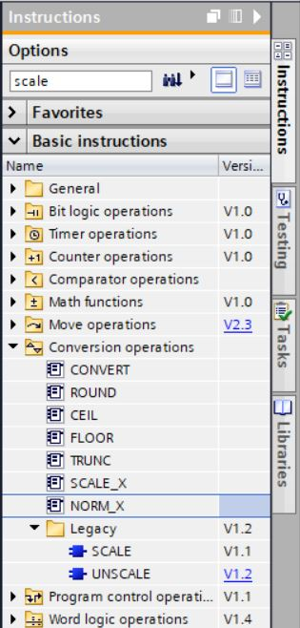
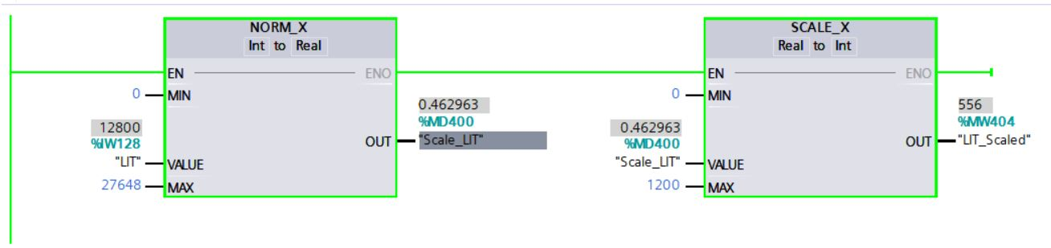
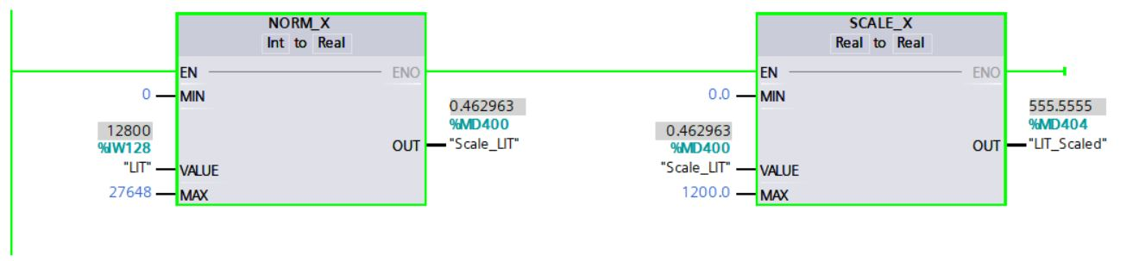
Scaling Analog Values
We would normalise the analog input 0 – 10 V / 0 – 27648 (Int) to 0.0 – 1.0 (Real)
Analog input to the VALUE
MIN and MAX would define the AI range
Variable @ OUT to capture the normalized value
Scale normalized value to 0 – 1200mm as required (note, it could scale to Int or Real as required)
Normalized value into VALUE
MIN and MAX would define the output range
Variable @ OUT would provide scaled value

Slide 13

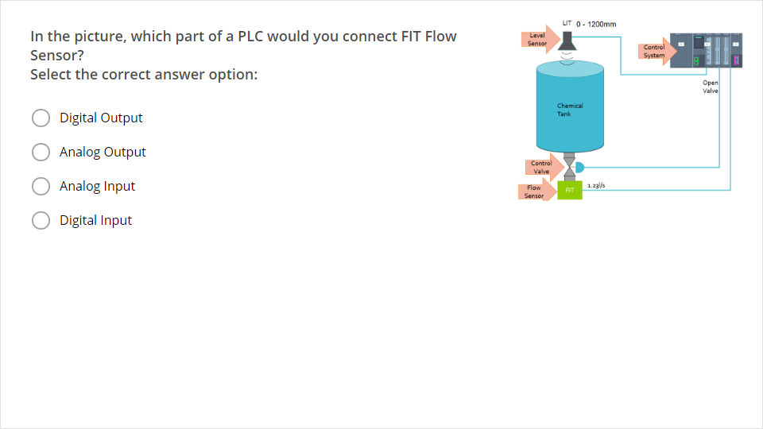
Quiz
Click the Quiz button to edit this object

